Slide 1
Analysis UCLA Protest Tweets
Group – 7
Ko Wing Sze, Dawn
Cheung Shing Ping, Eric
Cheung Hang Mang, Jeff
Capstone Project-Analysis of UCLA Protest Twitter

Slide 2
Introduction to the Dataset
The dataset used in this project contains tweets related to the protests at the University of California, Los Angeles (UCLA) in 2021. The dataset was collected and provided by the course instructors.

Slide 3
Project Overview
-Analyze the characteristics and patterns of tweets related to the UCLA protests.
-Identify the key topics, sentiments, and influential users involved in the protest discourse.
-Investigate the geographic distribution and temporal dynamics of the protest-related tweets.
-Provide insights that can inform future research or help understand social movements and collective action.

Slide 4
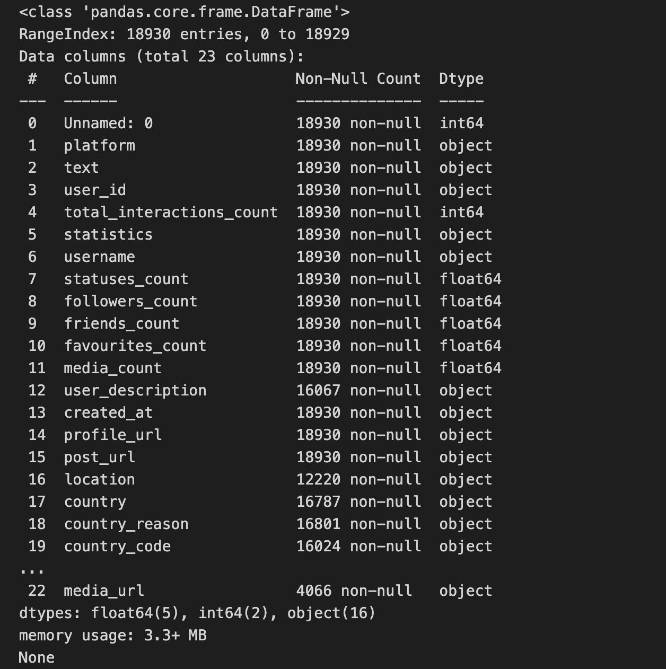
01
Dataset Characteristics
02
The dataset ：
18,930
23 columns
Each tweet contains information such as the text, user ID, user metadata
(e.g., follower count, friends count), timestamp, and other metadata related to the tweet.

Slide 5
Dataset Characteristics
03
The dataset covers a range of topics related to the UCLA protests, including the reasons for the protests, the actions taken by protesters, and the responses from the university administration and other stakeholders.

Slide 6
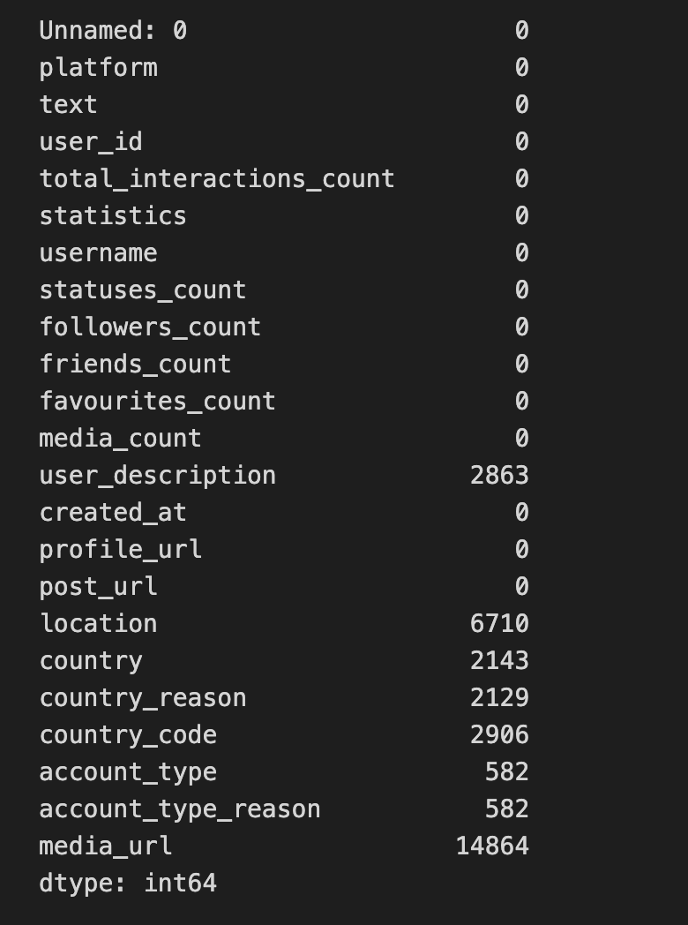
Data Preprocessing
Handling missing values: Identified and addressed missing values in the dataset, particularly in fields like user description, location, and media URL.

Slide 7
Data Preprocessing
Handling missing values
Identified and addressed missing values in the dataset, particularly in fields like user description, location, and media URL.
Extracting additional features
Derived additional features from the existing data, such as sentiment scores, hashtag usage, and user influence metrics.
Cleaning and formatting
Cleaned and standardized the data, such as removing duplicates, handling inconsistencies in column names, and converting data types as needed.

Slide 8
This project adopted a mixed-methods approach, combining quantitative and qualitative analyses to gain a comprehensive understanding of the UCLA protest-related tweets.
Research Approach

Slide 9
Research Approach
1.Exploratory Data Analysis (EDA)
2.Identifying Narratives and Topic
3.Identifying Key Opinion Leader
4.User Characterization
5.Assessing Potential Disinformation
6.Reporting and Interpretation

Slide 10
Potential reasons for the observed results
The predominance of positive and neutral sentiments may suggest that the protest movement garnered widespread support and resonance among the Twitter community.
The influential users identified likely played a pivotal role in shaping the narrative and amplifying the voices of the protesters.
The temporal dynamics of the tweet volume reflect the ebb and flow of the protest activities, with increased engagement during pivotal

Slide 11
Exploratory Data Analysis

Slide 12
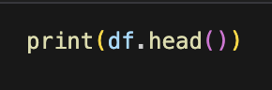
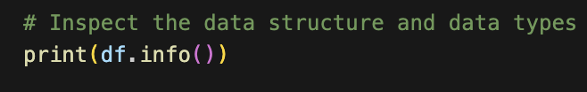
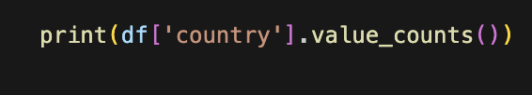
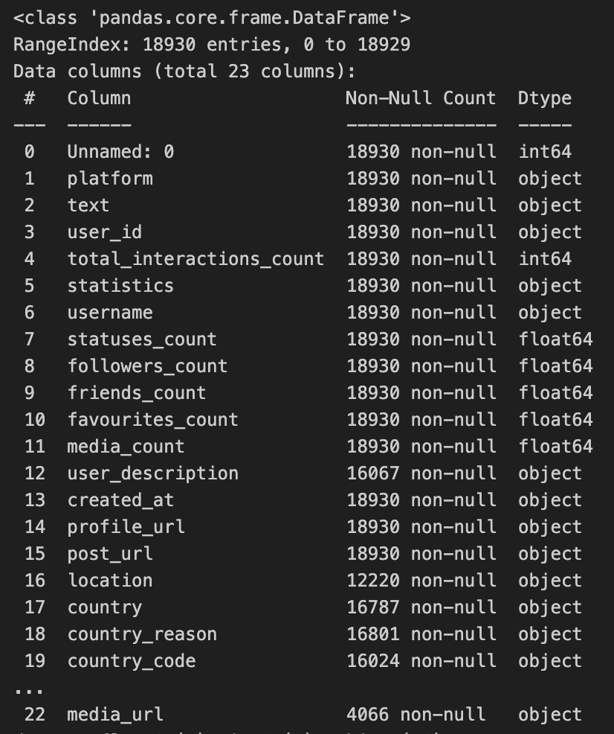
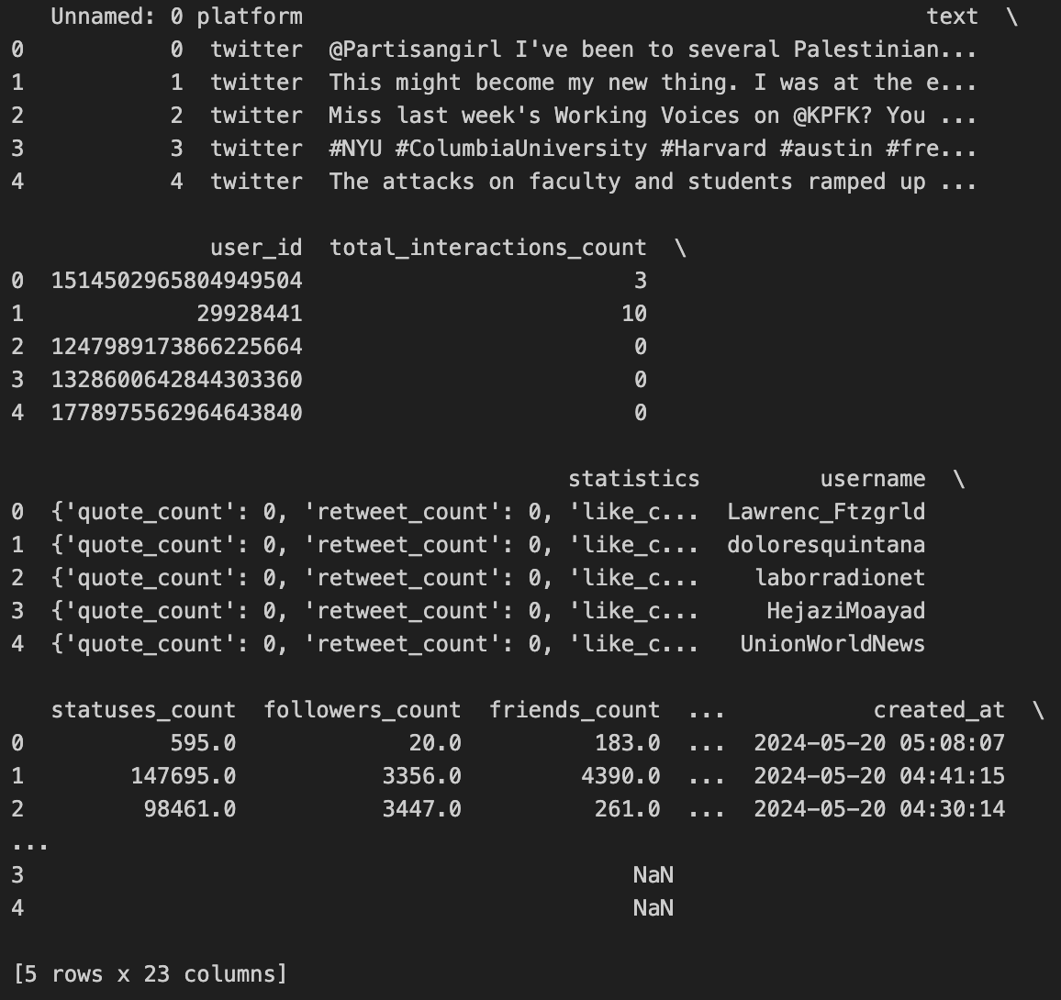
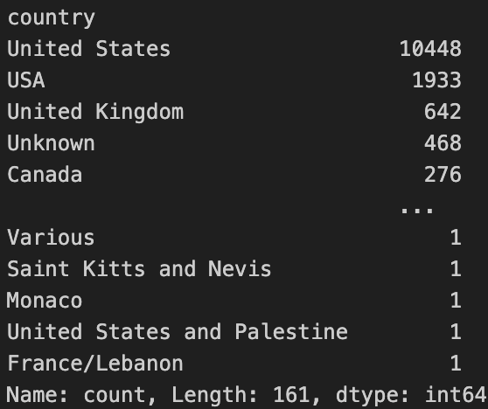
Exploratory Data Analysis

Slide 13
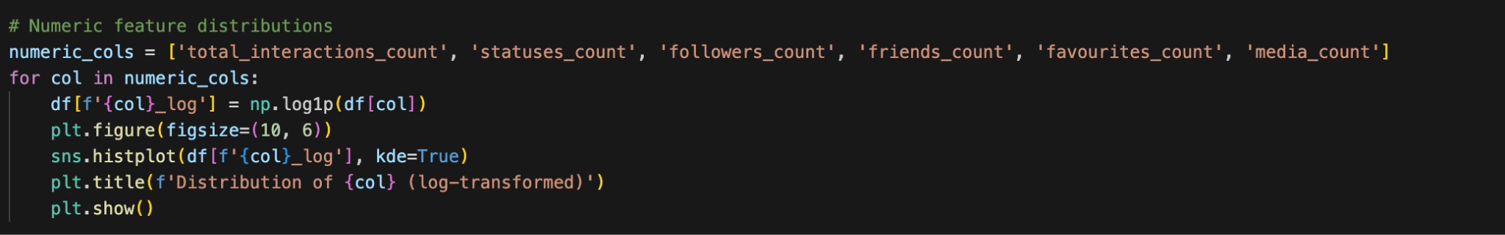
Numeric feature distributions

Slide 14
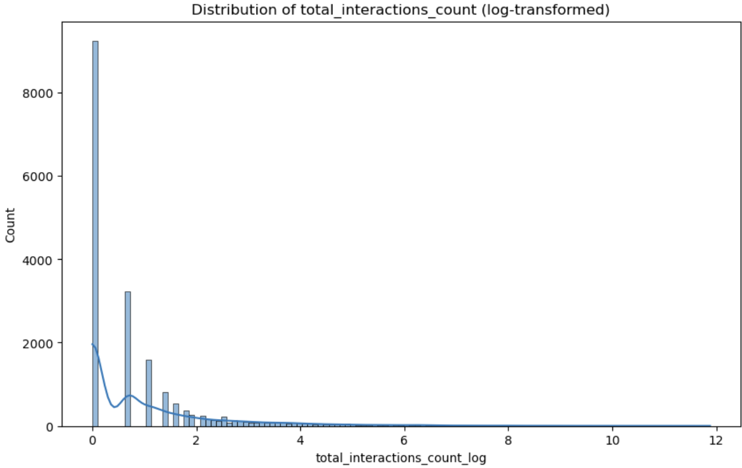
Numeric feature distributions
Most interactions occur at lower levels, with only a few instances of higher interaction counts. The graph likely depicts the distribution of total interaction counts, with a logarithmic scale indicating uneven data distribution.

Slide 15
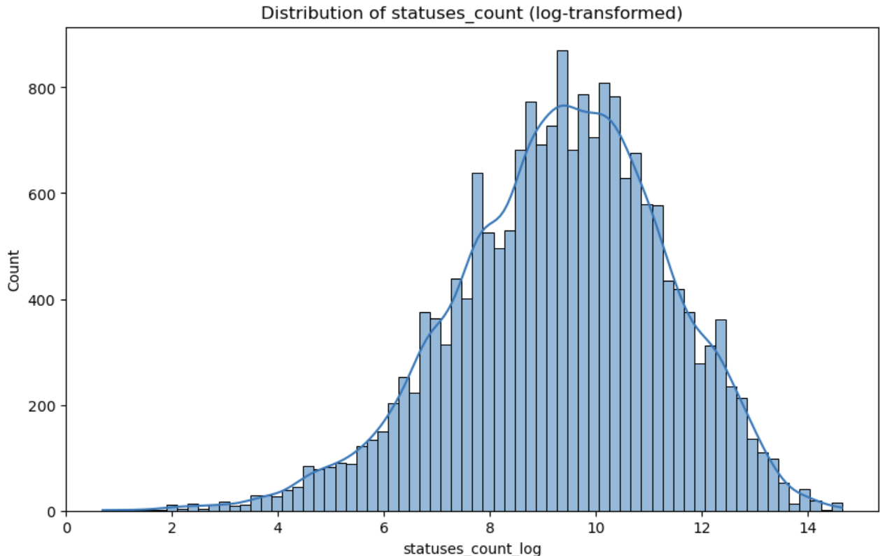
Distribution of Status Count
From the graph, it can be observed that the majority of the interaction counts are concentrated in the range of 10 to 15, forming a bell-shaped curve centered around 10. The shape of this curve resembles a normal distribution.

Slide 16
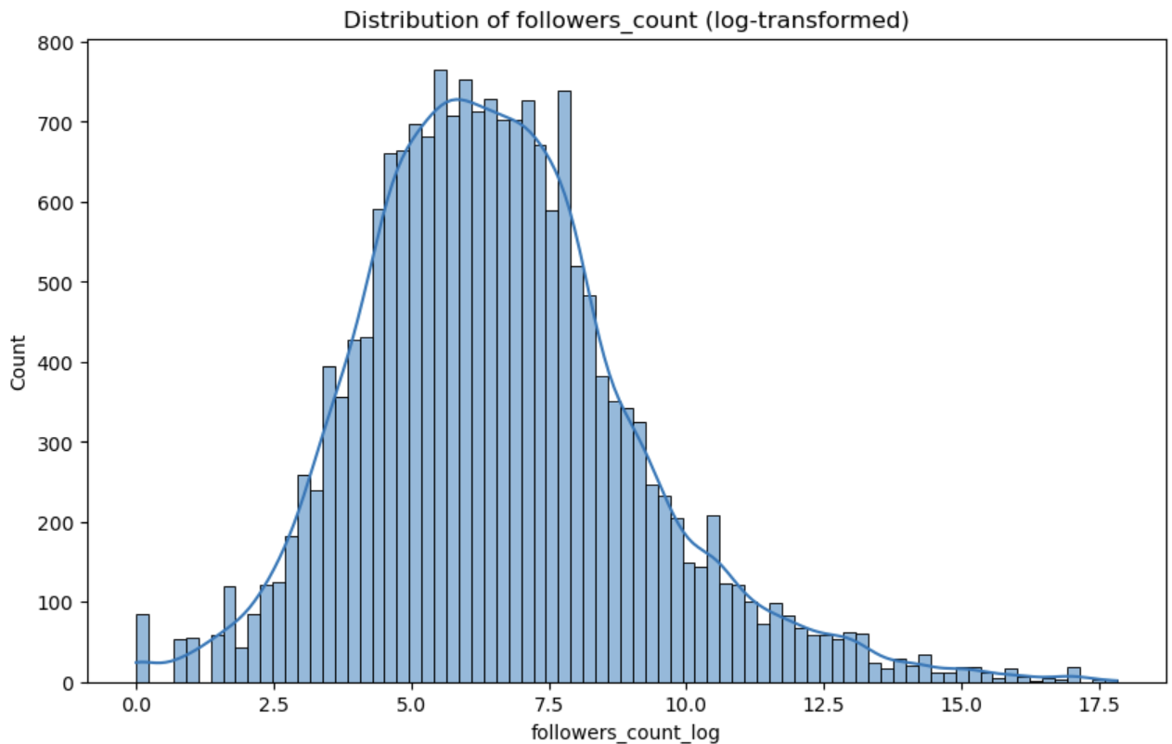
Distribution of Follower Count
Followers_count:
The distribution of this feature is right-skewed, with the majority of the data concentrated on smaller values, but there are also some relatively larger values present.

Slide 17
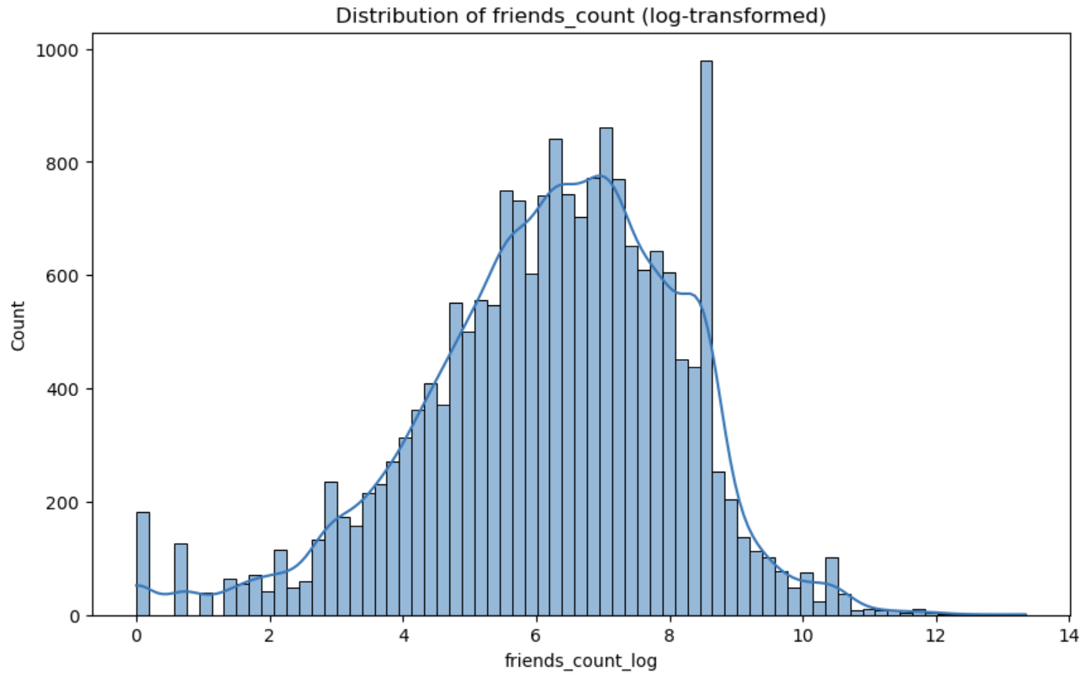
Distribution of Friends Count
Friends_count: The distribution of this feature exhibits a clear right-skewness, with the majority of the data concentrated on smaller values and only a few data points with larger values.

Slide 18
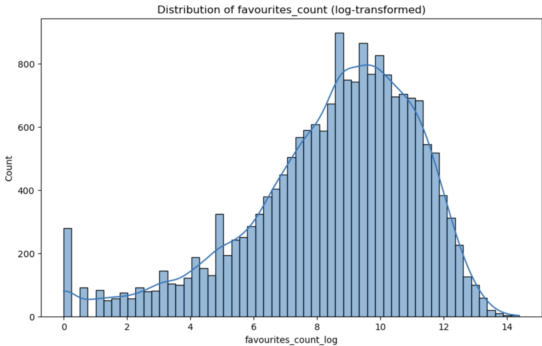
Distribution of favourites Count
favourites_count:
The distribution of this feature is right-skewed, with the majority of the data concentrated on smaller values, but there are also some relatively larger values present.

Slide 19
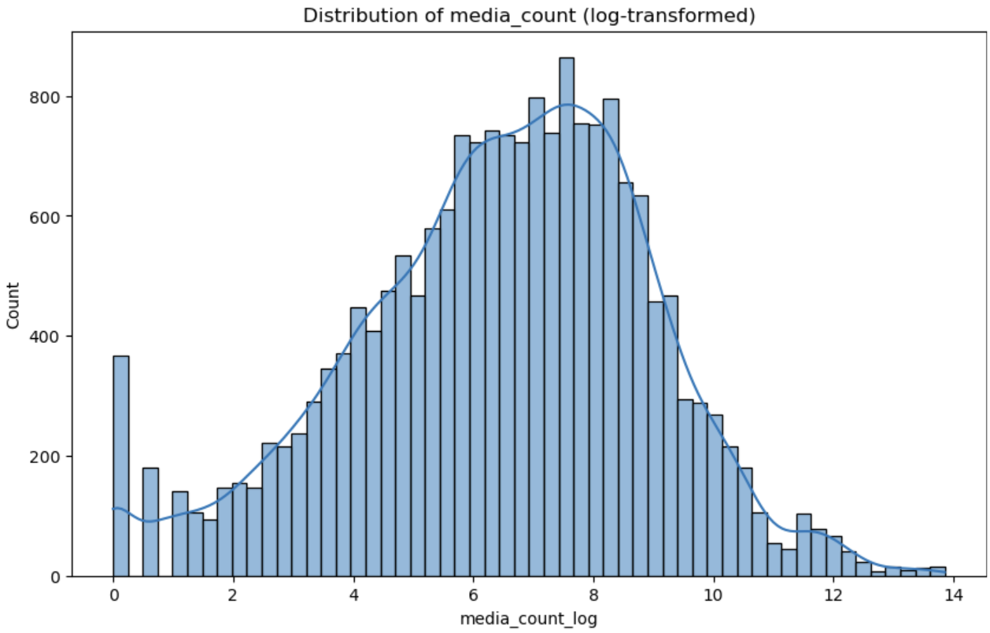
Distribution of Media Count
media_count:
The distribution of this feature is right-skewed, with the majority of the data concentrated on smaller values and only a few data points with larger values.

Slide 20
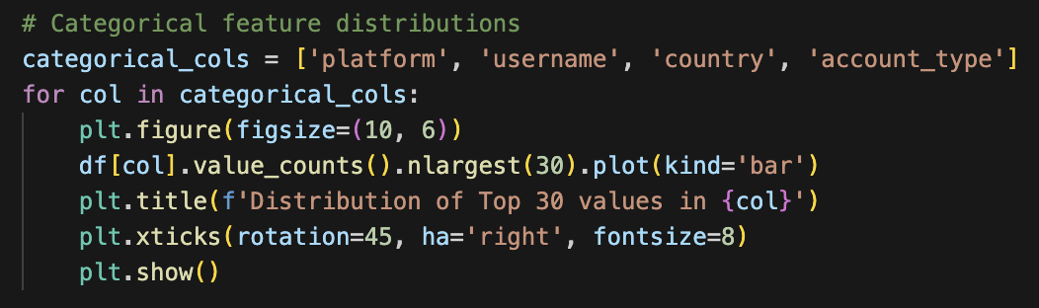
Categorical Feature Distributions

Slide 21
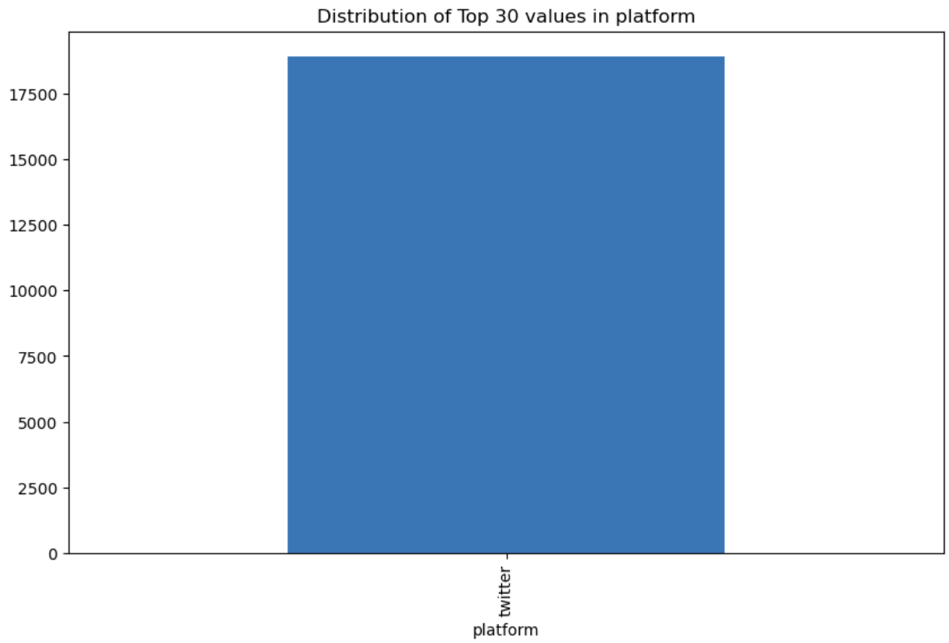
Distribution of tweets
For each categorical column (platform, username, country, account_type):
Bar plot showing the distribution of the top 30 values.
Title: "Distribution of Top 30 values in {column}".
Rotate x-axis labels by 45 degrees, align right, and set font size to 8.
Display the plot.

Slide 22
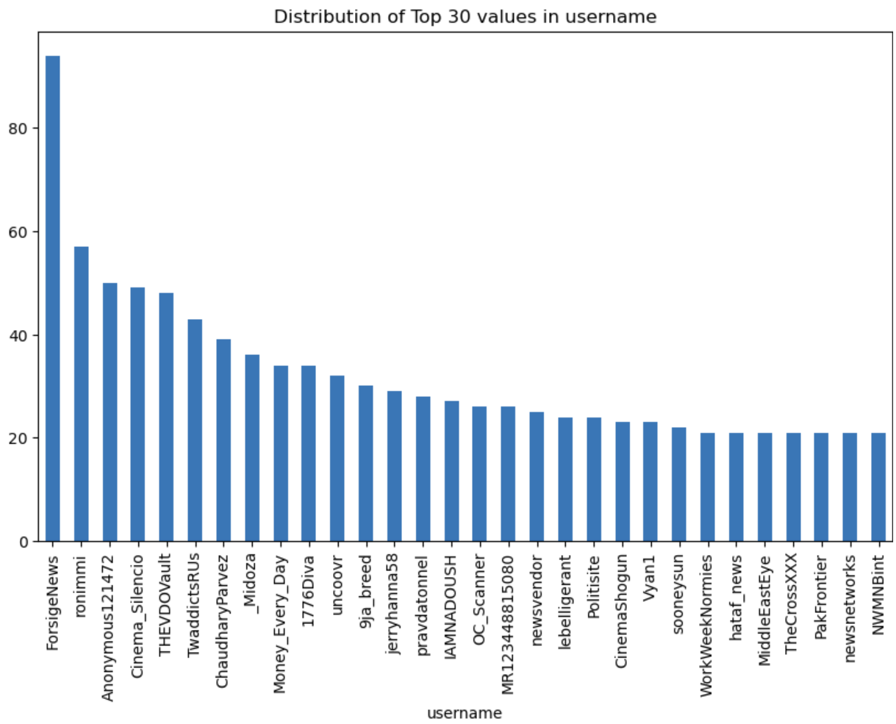
Distribution of Top 30 values in Username
ForsigeNews
Ronimmi
Anoymous121472
Cinema_Silencio
THEVDOVault

Slide 23
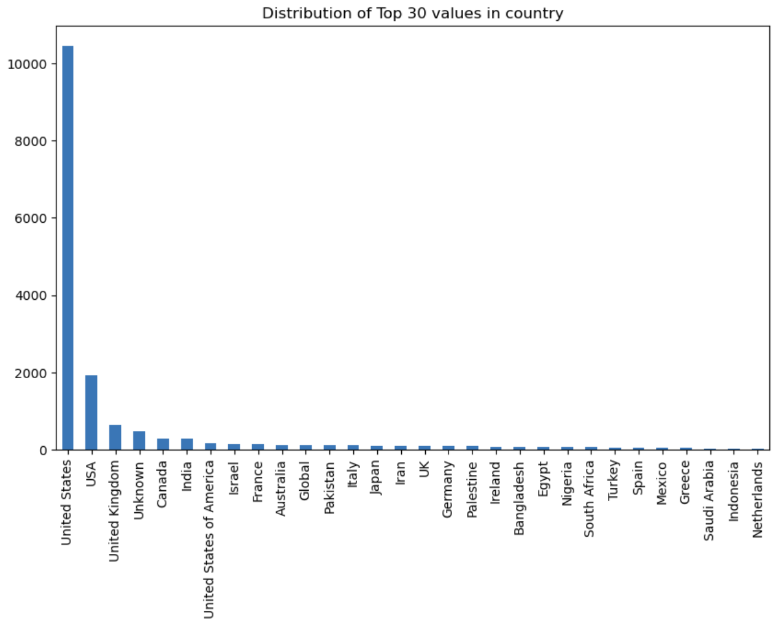
Distribution of Top 30 values in Country
United States
USA
United Kingdom
Unknown
Canada

Slide 24
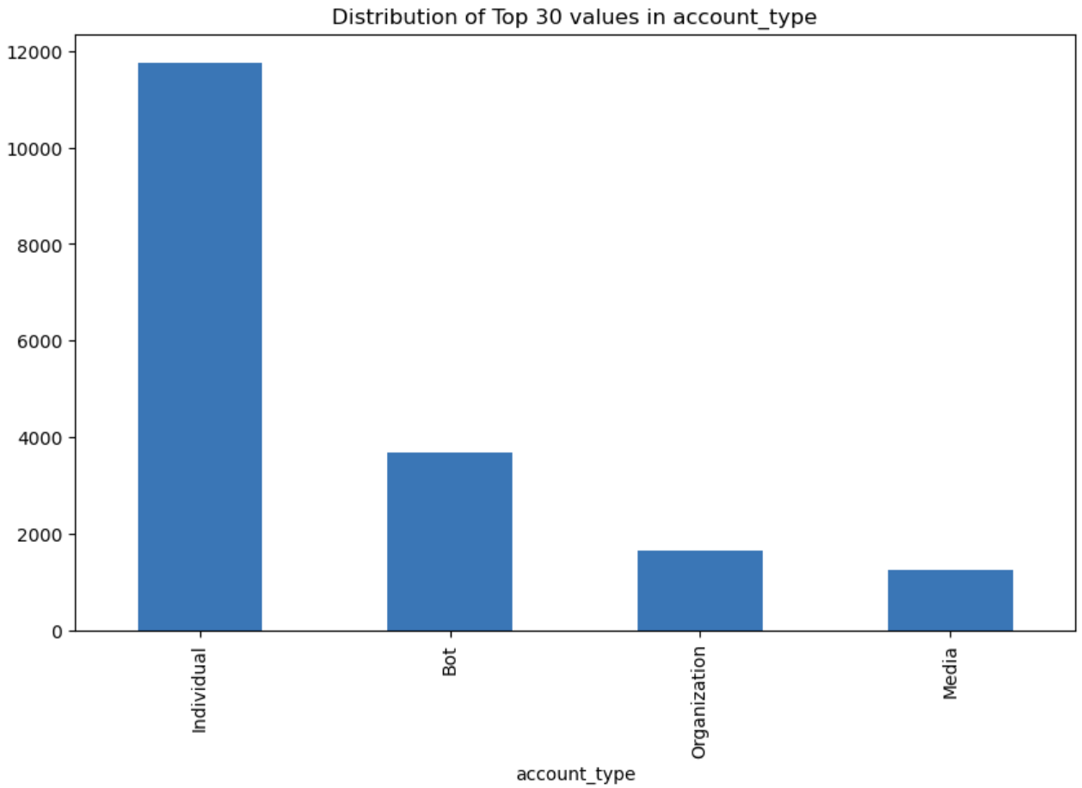
Distribution of Top 30 values in account type
Individual
Bot
Organization
Media

Slide 25
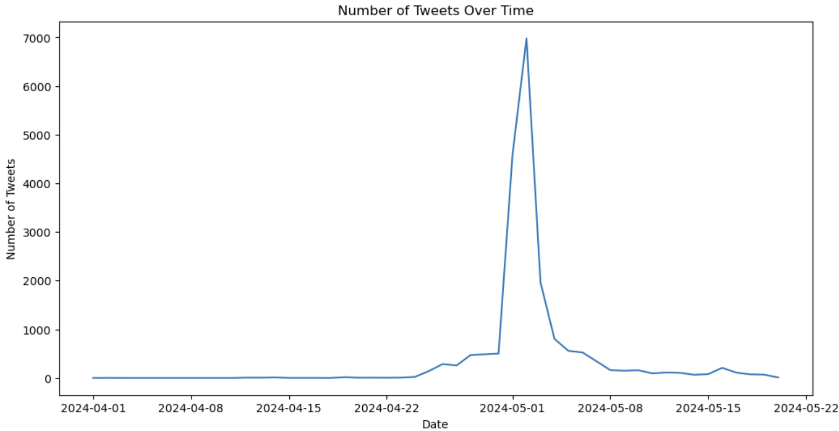
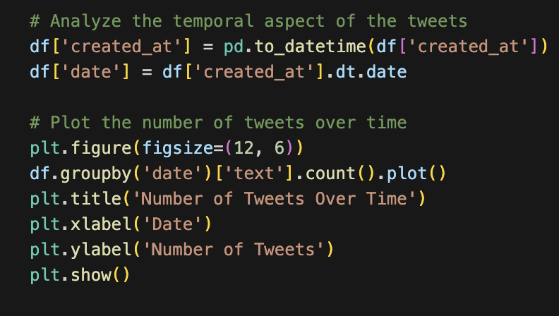
Analyze temporal aspect of tweets

Slide 26
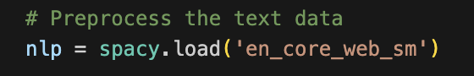
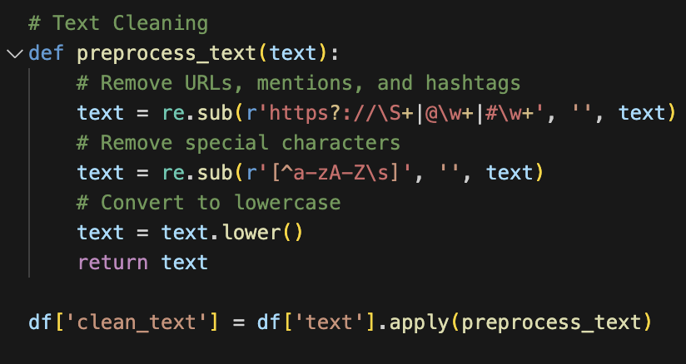
Identifying Narratives and Topics
Text Cleaning: Removal of URLs, mentions, hashtags, special characters, and conversion to lowercase.
Store the preprocessed text in df['clean_text'].

Slide 27
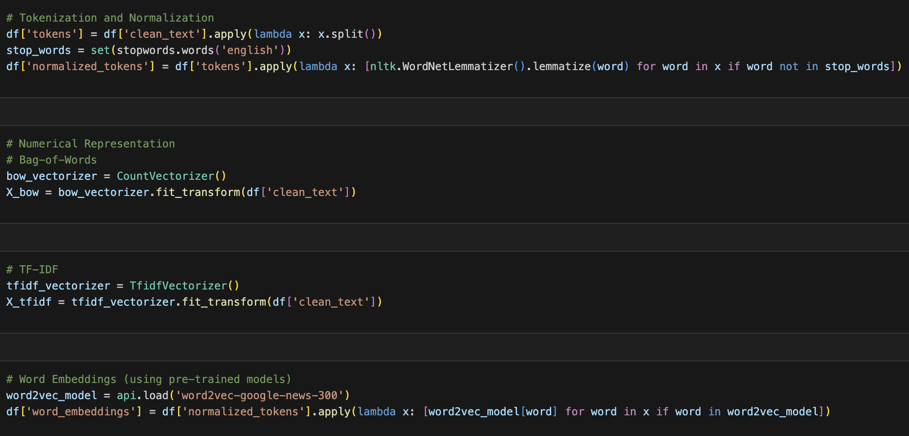
Identifying Narratives and Topics

Slide 28
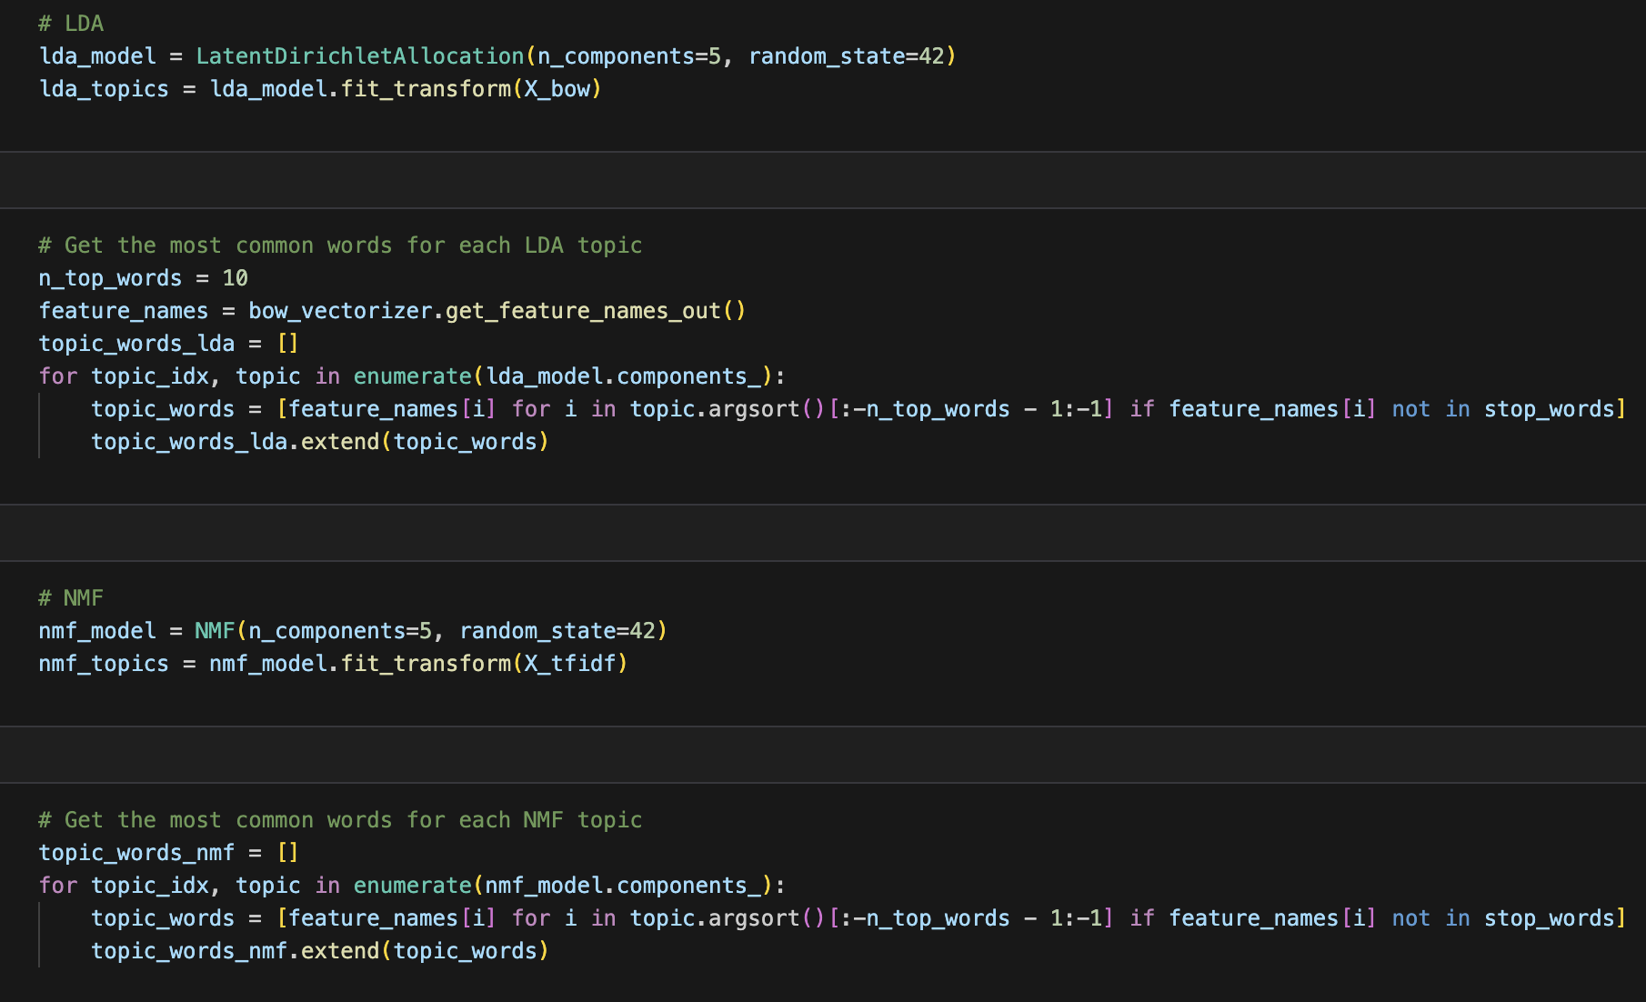
LDA and NMF
LDA model with 5 components and a random state of 42.
Transform X_bow using LDA model to obtain lda_topics.
Get the most common words for each LDA topic (n_top_words = 10).
Create a list topic_words_lda containing the top words for each LDA topic, excluding stop words.

Slide 29
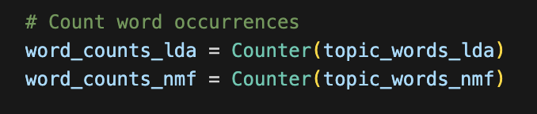
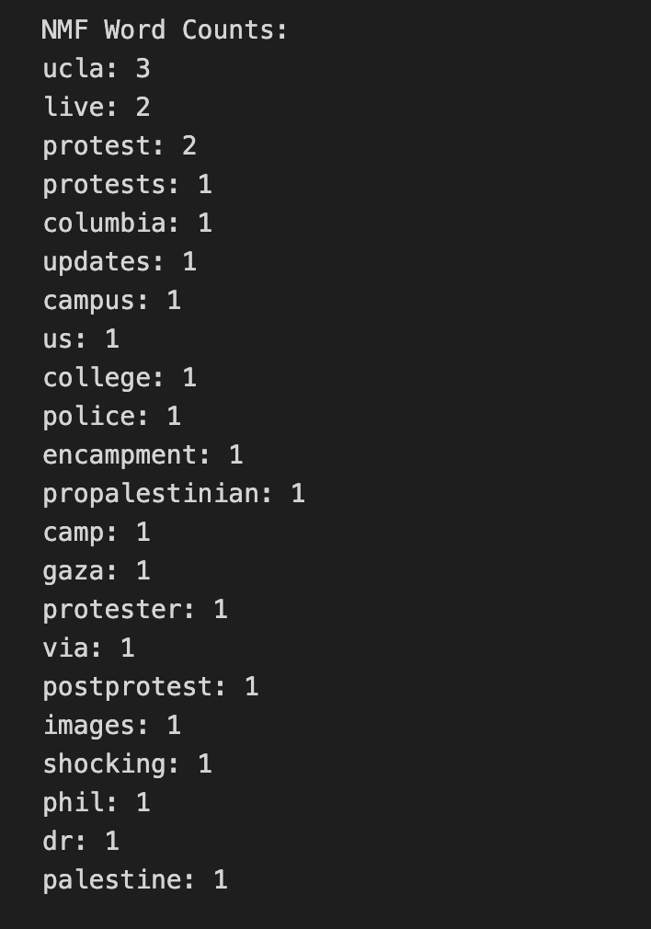
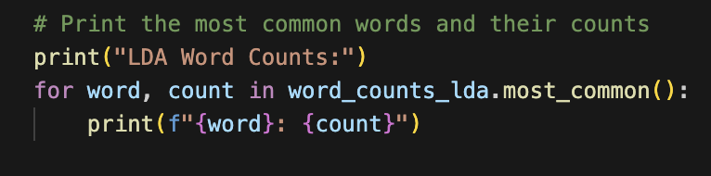
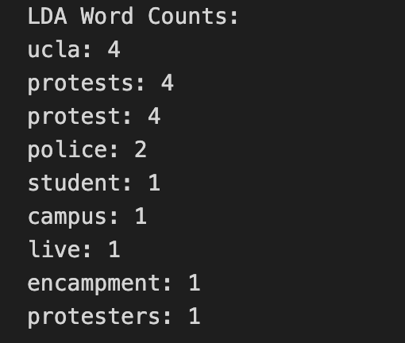
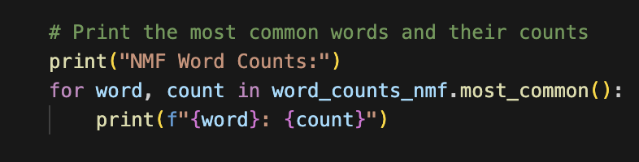
LDA and NMF
NMF Word Counts
LDA Word Counts

Slide 30
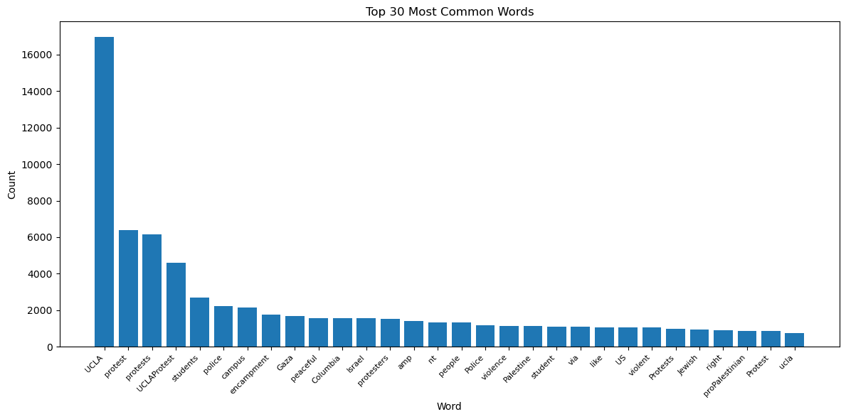
Top 30 most common words
UCLA : 16963
protest : 6394
protests: 6152
UCLAProtest : 4600
students: 2700

Slide 31
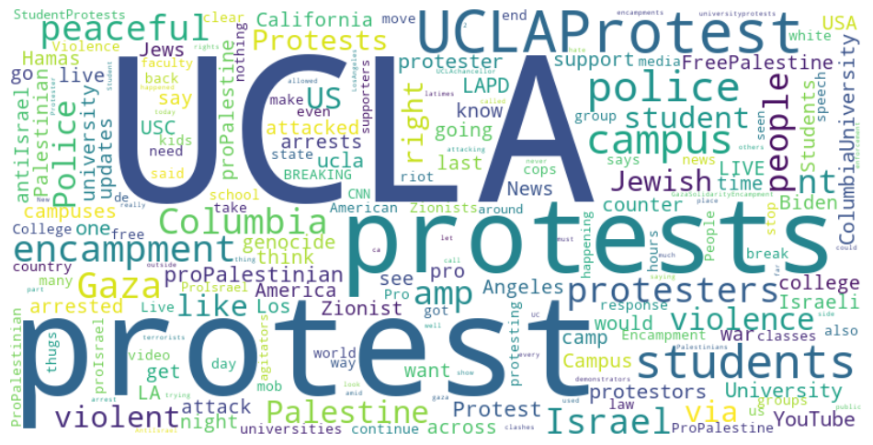
Word Cloud
The words that stand out prominently are
"UCLA"
"protest"
"protests
“UCLAProtest"
“Students”
“Campus”

Slide 32
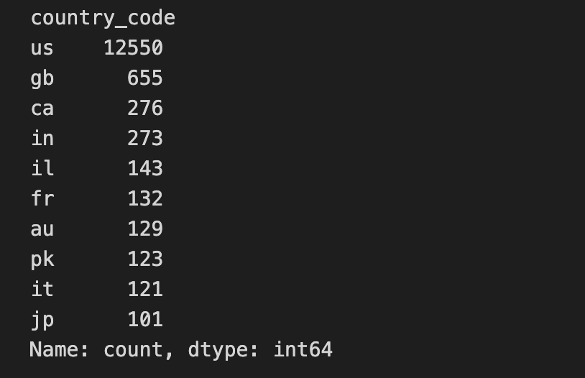
Counts Top 10 Country
United States (US) - 12550
United Kingdom (GB) - 655
Canada (CA) - 276
India (IN) - 273
Israel (IL) - 143
France (FR) - 132
Australia (AU) - 129
Pakistan (PK) - 123
Italy (IT) - 121
Japan (JP) - 101

Slide 33
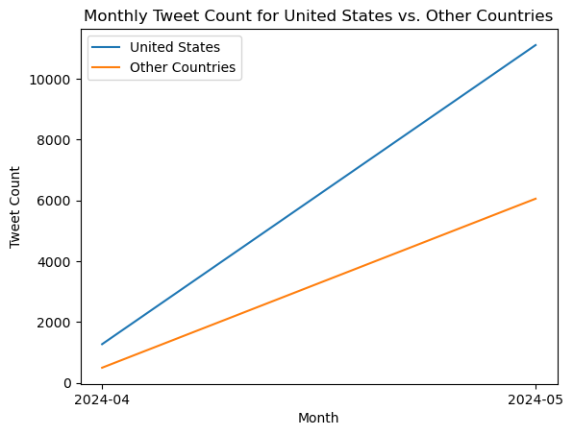
Monthly Tweet Count for United States vs. Other Countries
Based on the provided graph, we can draw the following conclusions:
The graph displays the number of Twitter users in different countries. It is evident from the graph that the United States has a significantly higher number of Twitter users compared to other countries. The Twitter user counts in other countries are relatively lower.

Slide 34
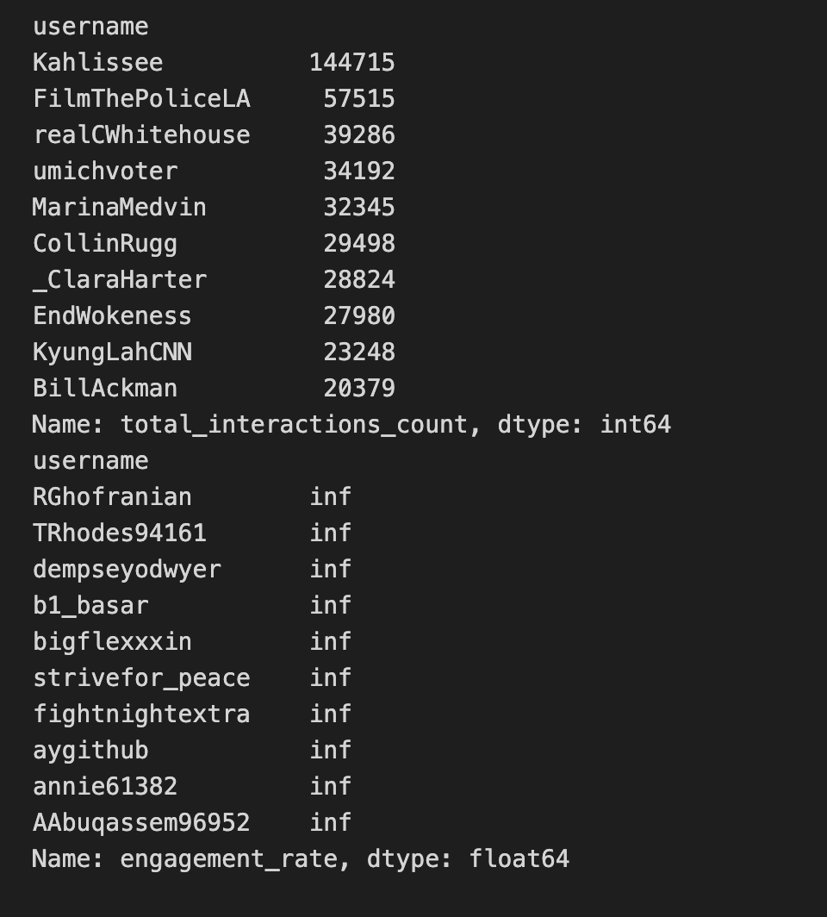
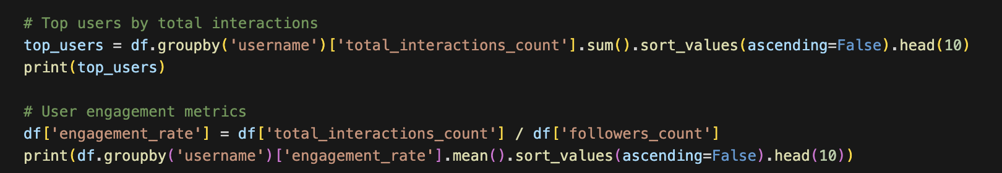
Total Interactions Count
The user with the highest total interactions is Kahlissee, with 144,715 total interactions.
The other top 10 users also have very high total interactions, ranging from 20,000 to 60,000.

Slide 35
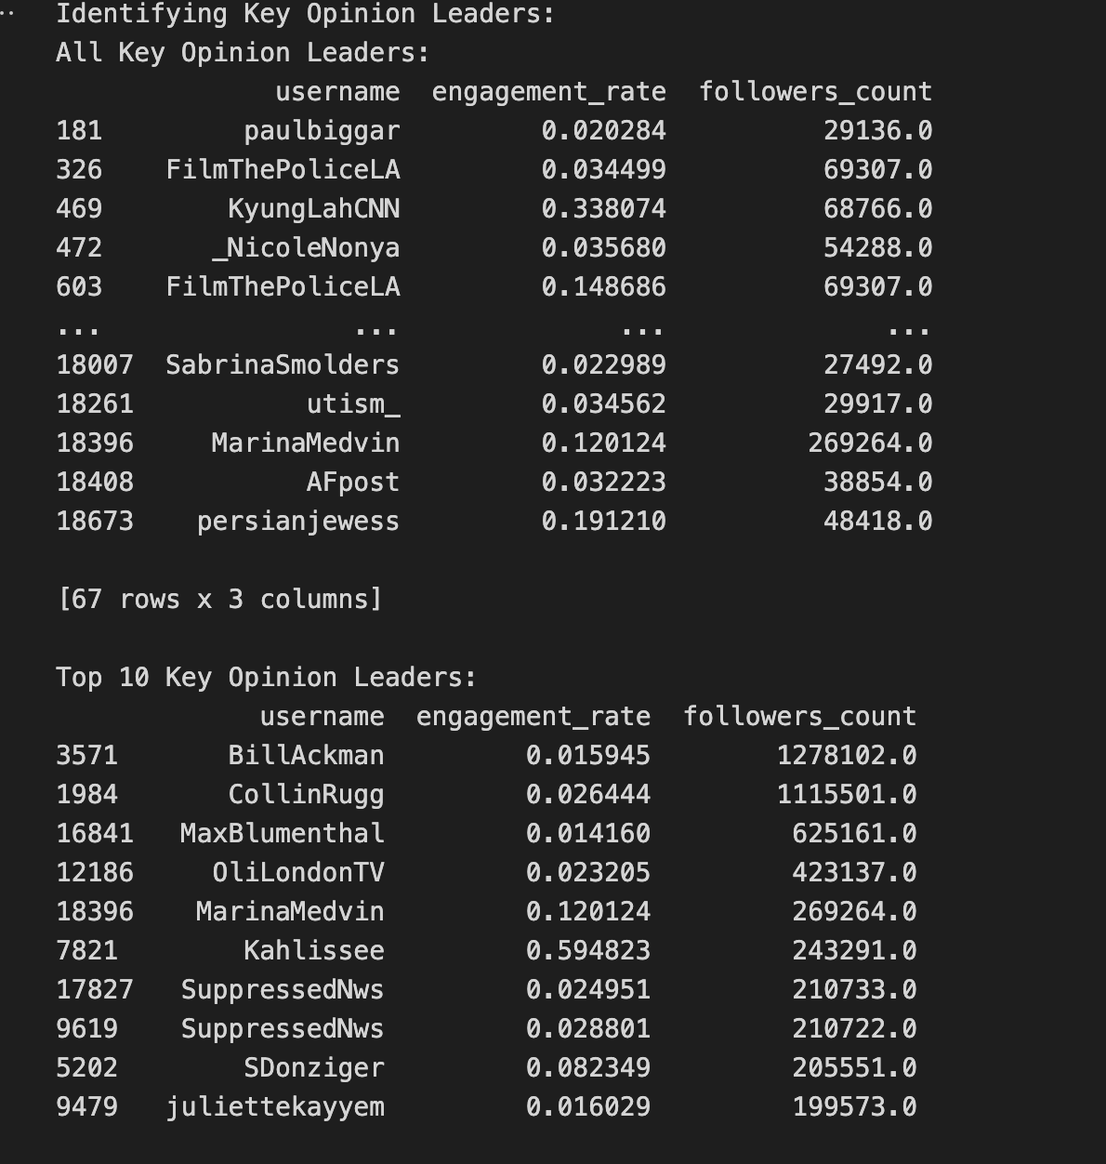
Key Opinion Leaders（KOL）
There are a total of 67 Key Opinion Leaders (KOLs) in the dataset. The engagement_rate represents the participation rate, and followers_count indicates the number of followers.
Among all the KOLs, the top 10 KOLs with the highest engagement_rate are as follows
These KOLs have high engagement rates on Twitter, and they also have a relatively large number of followers. This data is valuable for people analyzing the influence and participation of these Twitter accounts.

Slide 36
User Characterization

Slide 37
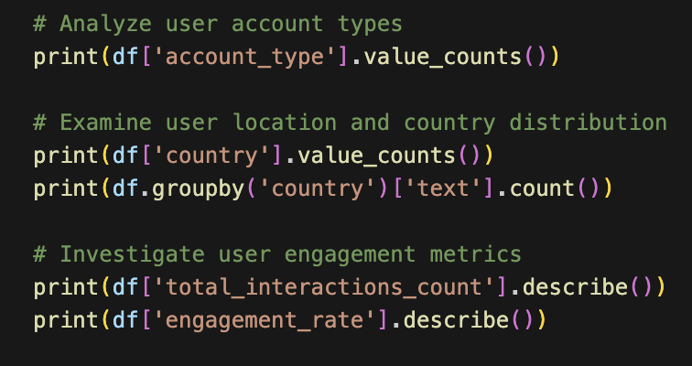
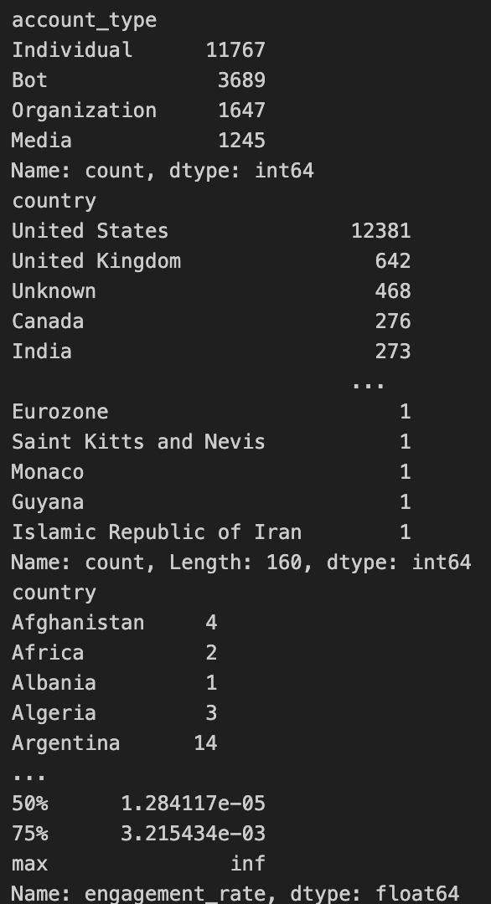
Analyze user account types
User Account Types: Analyzing distribution provides insights into different account types.
User Location and Country Distribution: Examining value counts reveals user location distribution and country-wise user counts.
User Engagement Metrics help understand user engagement levels.

Slide 38
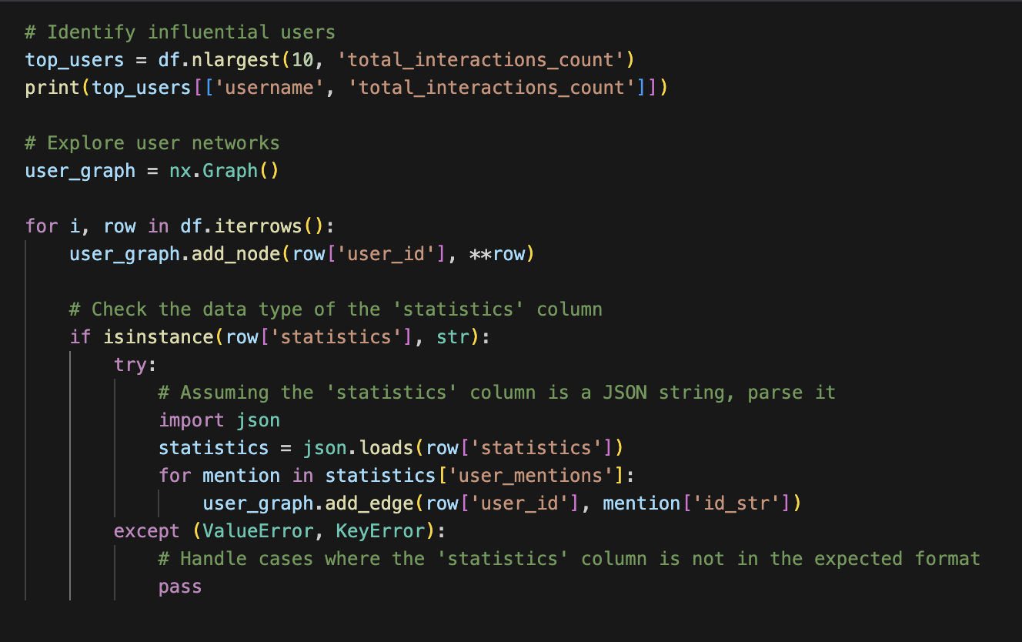
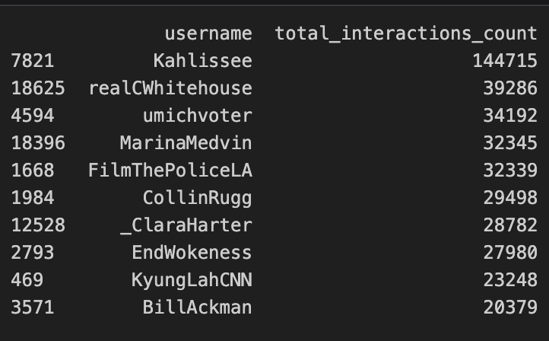
Identify Influential Users

Slide 39
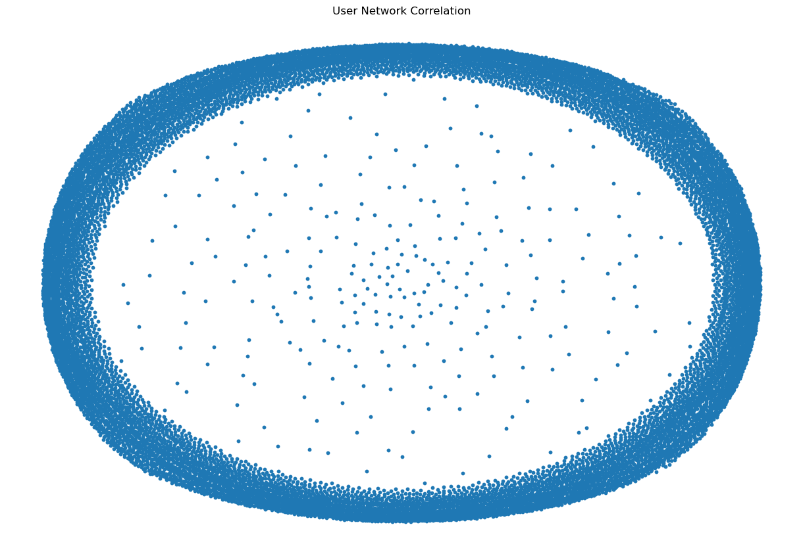
User Network Correlation
User network correlation visualization using a spring layout.
Node size is set to 10 for the visualization.

Slide 40
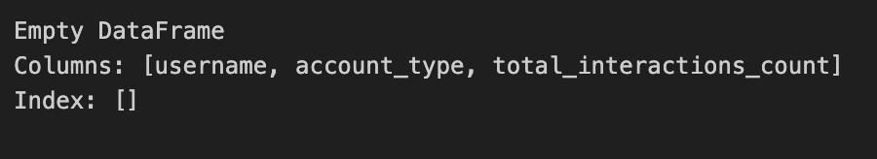
Identify potentially suspicious accounts
Identify potentially suspicious accounts
Suspicious accounts: Accounts classified as 'bot' or 'suspicious'.
Display the usernames, account types, and total interaction counts of the suspicious accounts.

Slide 41
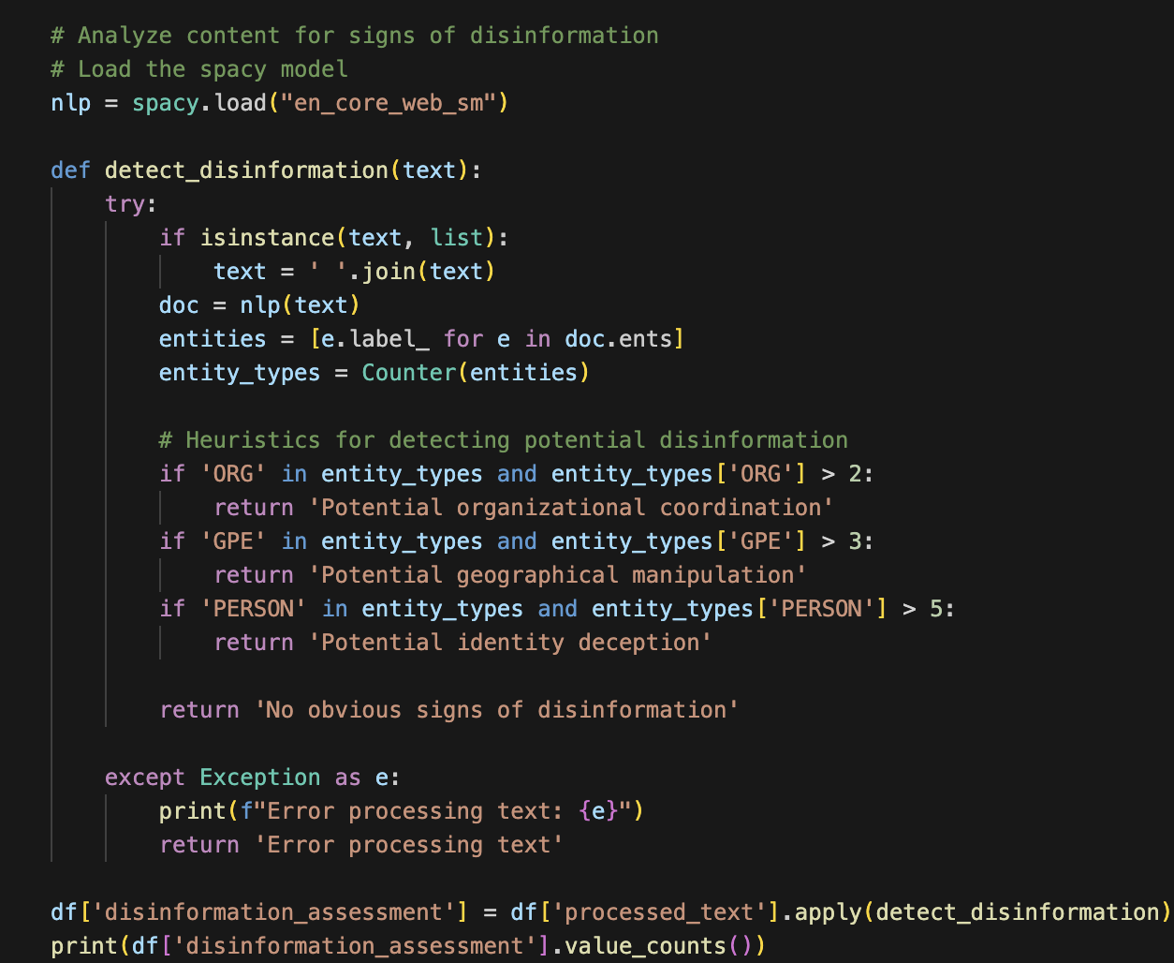
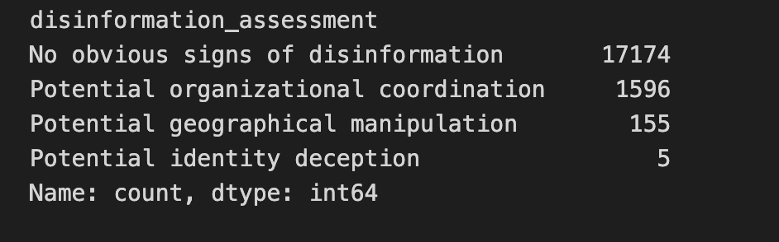
Analyze content for signs of disinformation
-Function detect_disinformation(text) uses heuristics to detect potential disinformation based on entity types.
-Resultant disinformation assessments are stored in df['disinformation_assessment'].
-Value counts of disinformation assessments are printed.

Slide 42
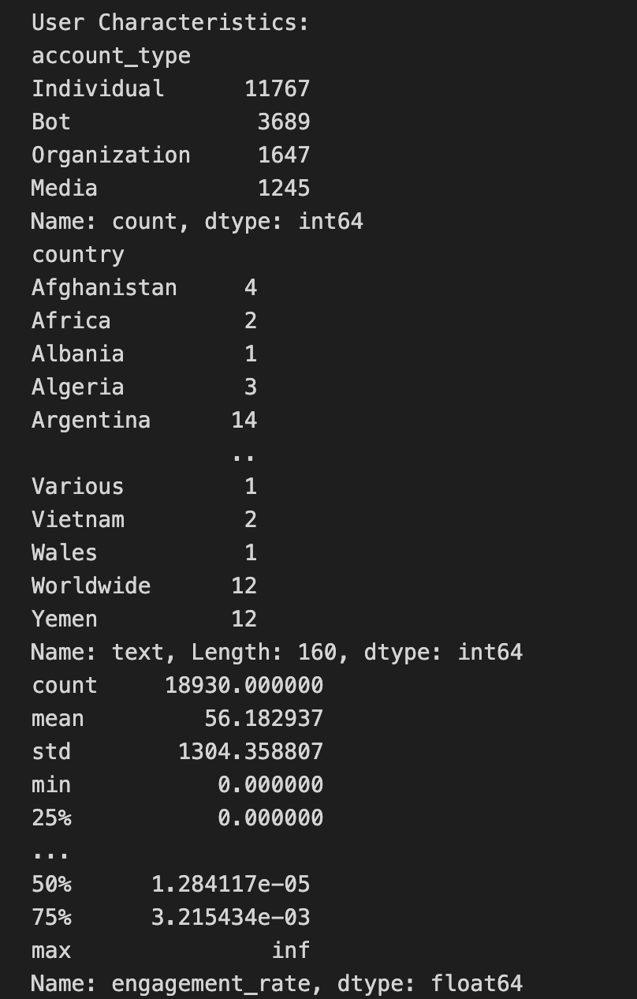
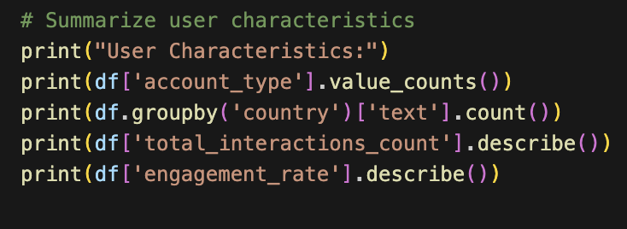
Summarize user characteristics
User Characteristics: Account type distribution, country-wise post count, total interactions count statistics, and engagement rate statistics.

Slide 43
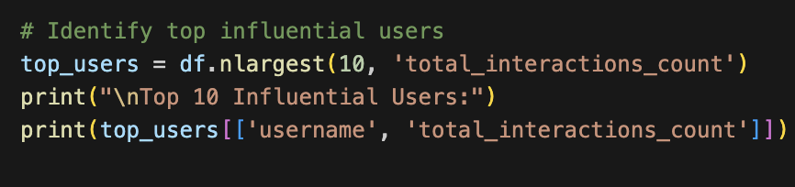
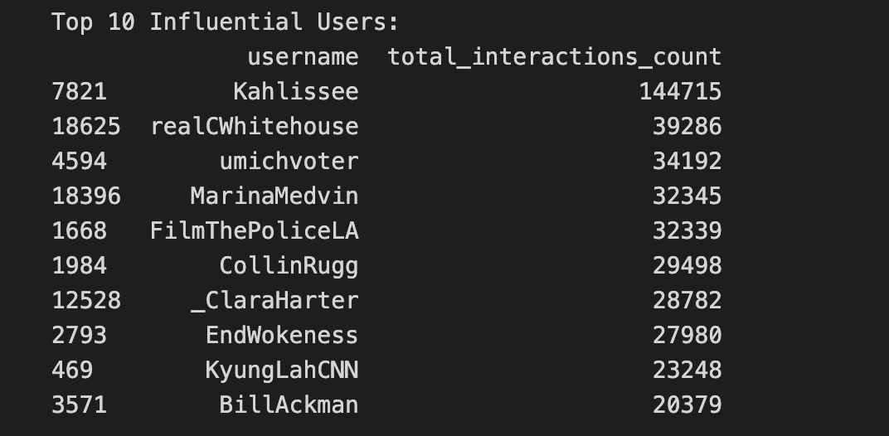
Top 10 Influential Users
Top 10 Influential Users: The usernames and total interaction counts of the top 10 influential users.

Slide 44


Overall summary
Dataset summary: Information about the dataset and its descriptive statistics.

Slide 45


Engagement Analysis
Average engagement rate: {average_engagement_rate}
Top 10 most engaging posts: The text and engagement rate of the top 10 most engaging posts.

Slide 46


Geographical Analysis
Number of unique countries: {number_of_unique_countries}
Top 30 Countries: Value counts of the top 30 countries.
Bar plot showing the top 30 countries and their counts.

Slide 47


Account Age Analysis
-Average account age: {average_account_age} days
-Account Age Distribution: Histogram plot of account ages (days)

Slide 48


Disinformation assessment
Disinformation assessment: Value counts of the disinformation assessment category.

Slide 49
Challenges and Limitations

Slide 50
Thank you

